Slide 1
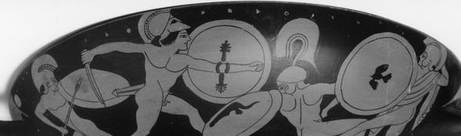
Greek Vases
Javiera Astudillo, Andrew Lee, Diego Zertuche

Slide 2
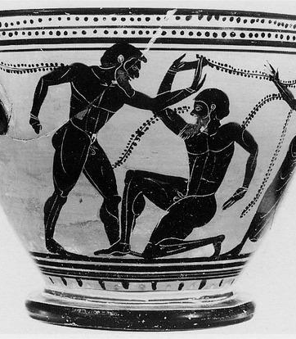
Introduction
Greek vases: allow to study greek society.
Corpus Vasorum Antiquorum: 100,000 vases in 24 countries.
Selection by object presence
Automatic object detection?
Notes:
Greek vases allow to study greek society and are available in vast amounts.
For instance, the Corpus of Ancient Vases, a notorious Greek pottery catalogue, has around 100,000 vases
Typically when carrying out research, researchers select vases that contain specific objects, such as shields.
But given the huge amount of vases, this task is super time-consuming.
It would be great to have an automatic object detection system that select vases that contain shields.
Here is where our project comes in.
#The study of ancient greek art facilitates the understanding of Greek society
#Within them, the most vastly available are greek vases, and hence their importance in the study of greek society.

Slide 3
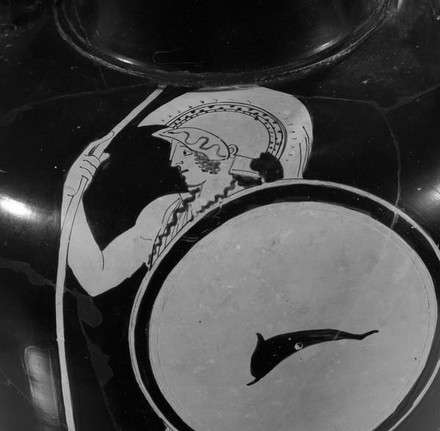
Project overview
Goals
Detect the presence of shields within vase images
Detect the location of the shield within the image
Notes:
Our first goal was to detect the presence of shields within vase images and in second stage be able to detect the location of the shield within the image. Each of them is carried on with a different model.

Slide 4
DATA

Slide 5
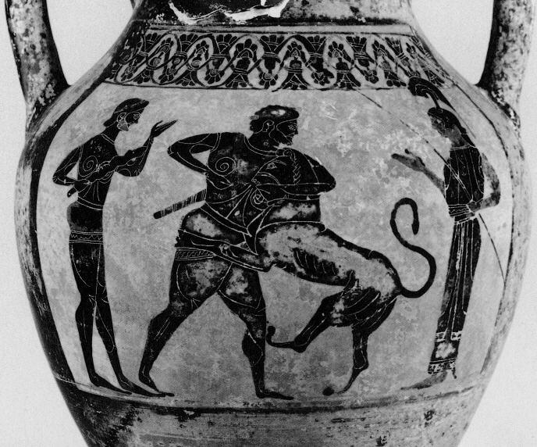
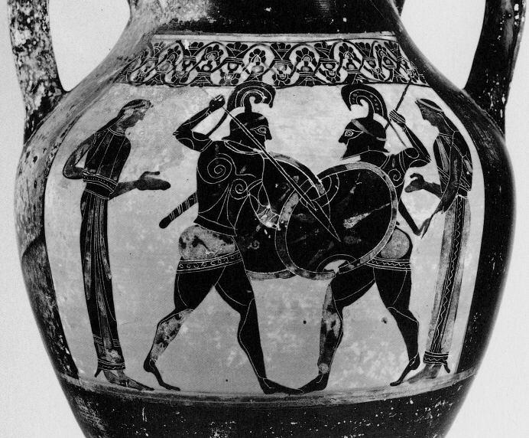
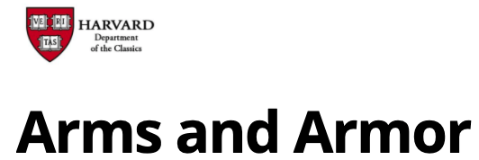
EDA
Example: Vase 37 with “shield” tag
170,000 vases images from armsandarmor
5,500 with shield tags
1,800 with actual shields
Notes:
We used images from Armsandarmor, a Harvard hosted catalogue of greek vases images.
We made a first selection of 5,500 images that contained “shield” within their tags. After a first analysis, we realized that only some of them contained shields. After hand selecting the images that had shields, we were left with 1,800 shield images.
# This was because the descriptions were common to all pictures belonging to a given vase, but only some angles contained the shields.

Slide 6
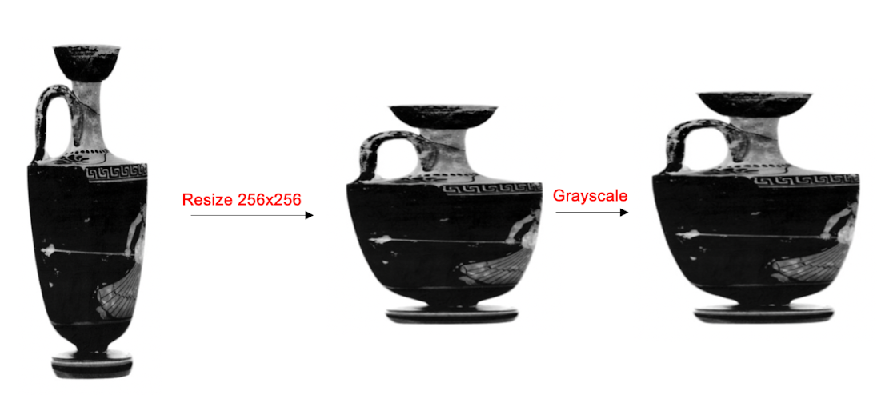
Data Wrangling & Preprocessing
We decided to resize all images to 256 by 256 pixels and convert them to grayscale. This provided more manageable images that were still complex enough to train our models with.

Slide 7
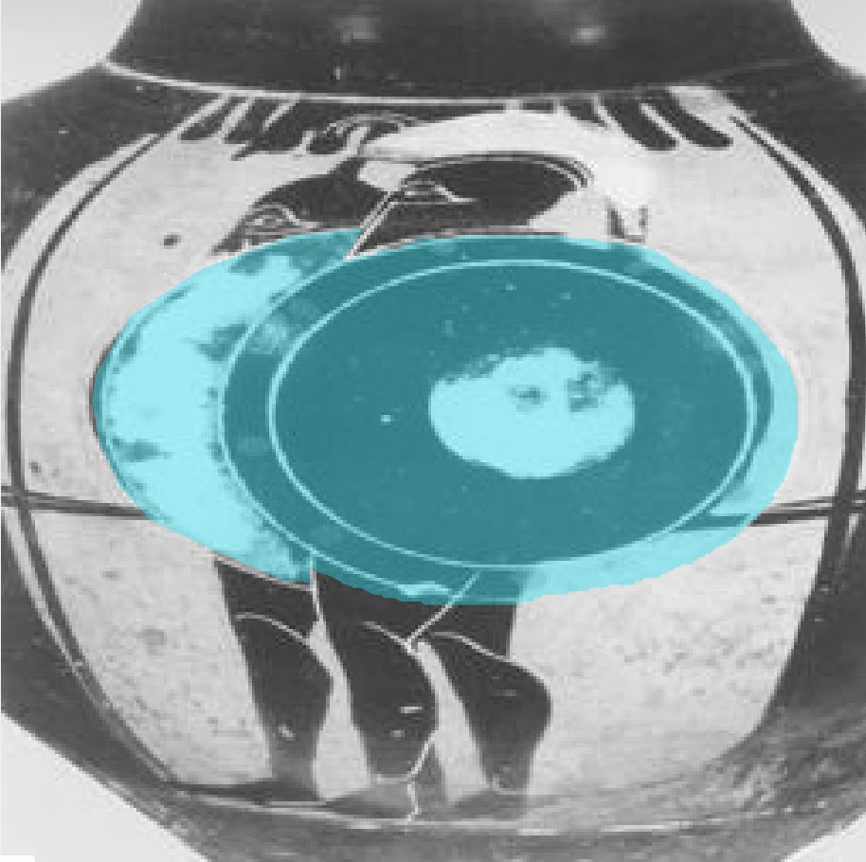

Data Wrangling & Preprocessing: Masking

Slide 8
Data Wrangling & Preprocessing
Classification dataset
1,800 images with shields
1,800 images without shields
Train: 80%, Validation:10%, Test:10%
Segmentation dataset
900 images with shields with masks
Train: 80%, Validation:10%, Test:10%

Slide 9
MODELS

Slide 10
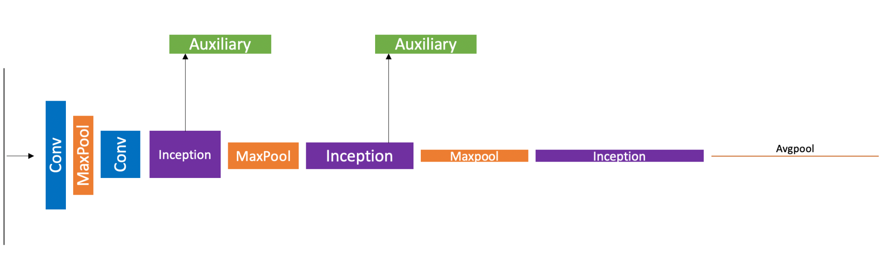
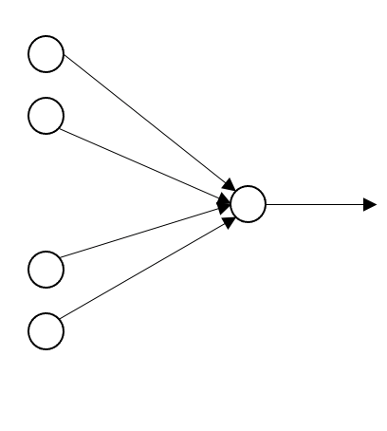
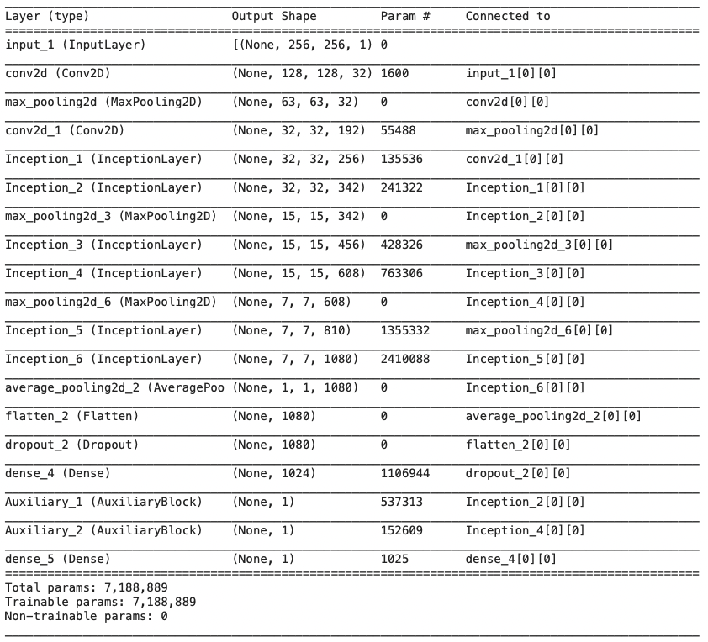
Classification model: Inception Model
Number of parameters
7,188,889
Number of epochs
100
Optimizer
Adam
Loss
Binary cross-entropy
Input
Image (256x256)
Output
Shield probability ([0,1])
Notes:
Auxiliary blocks are making predictions that allow the gradients to flow through those blocks and hence preventing vanishing gradients

Slide 11
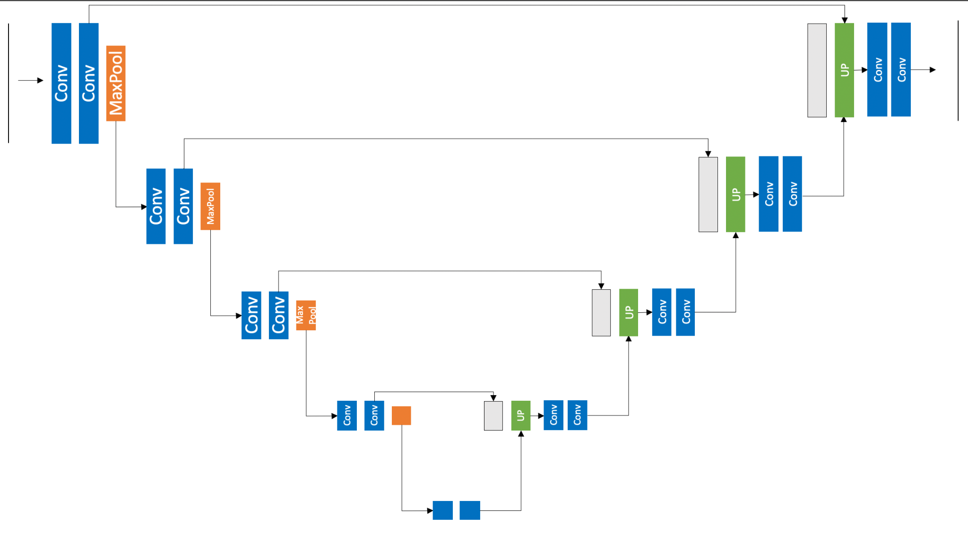
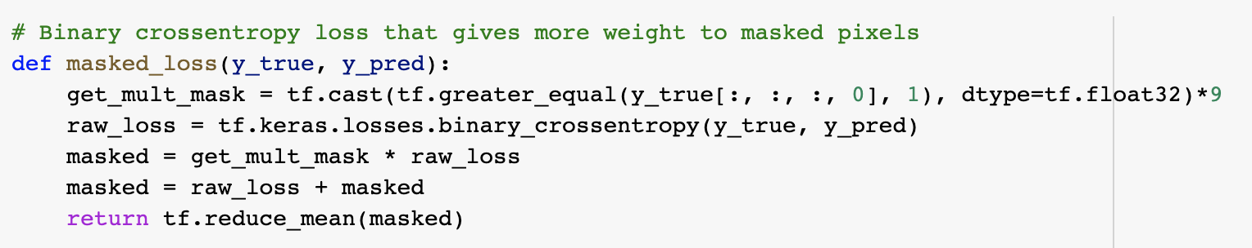
Segmentation Model: U-Net
Number of parameters
688,129
Number of epochs
50
Optimizer
Adam
Loss
Weighted** binary cross-entropy
Input
Image (256x256)
Output
Predicted mask (256x256)

Slide 12
RESULTS

Slide 13
Results Classification
 | Accuracy Score | F1 Score
Train Set | 0.64 | 0.66
Test Set | 0.65 | 0.68

Slide 14
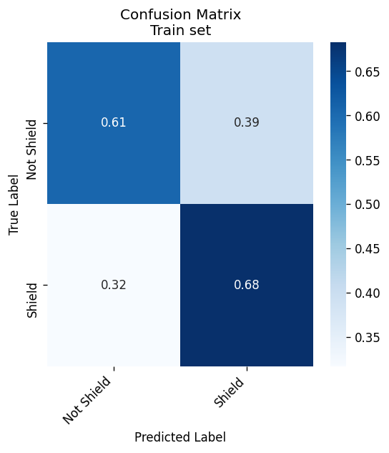
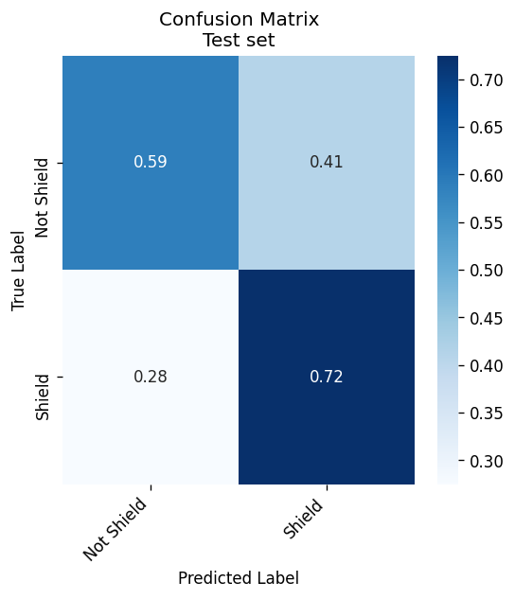
Results Classification

Slide 15
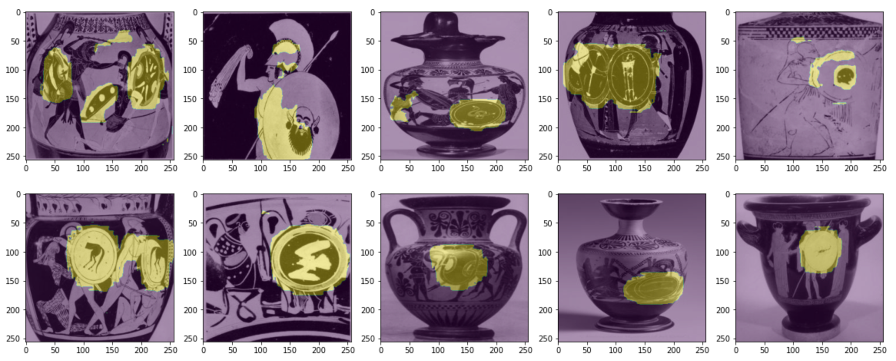
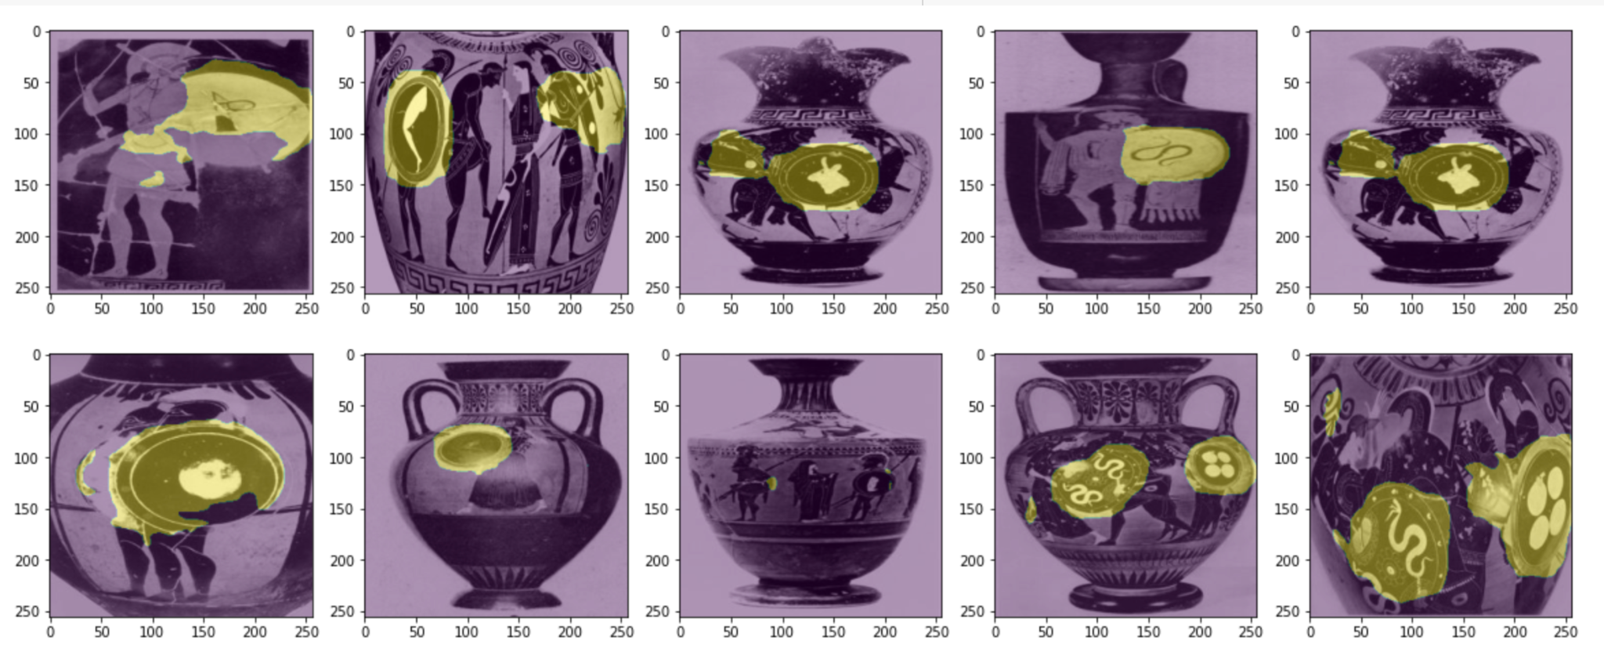
Results Segmentation
 | DICE
Train Set | 0.681
Test Set | 0.7128

Slide 16
THANKS

